Slide 1


ANNSHUL SAJWAN
Email-Annshulsajwan28@gmail.com
Linkdin-www.linkedin.com/in/annshulsajwan
SQL Sales Analysis And Optimization

Slide 2



Introduction
In this project, we analyze pizza orders using SQL queries to gain insights into customer preferences, sales performance, and operational trends. By examining a dataset, we apply various SQL techniques—from basic aggregations to advanced window functions—to address real-world business challenges. The goal is to offer actionable insights for improving menu options, pricing strategies, and inventory management.

Slide 3

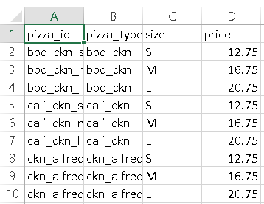
Datasets Used
Orders (orders.csv)
Order Details (order_details.csv) Pizza Types (pizza_types.csv) Pizzas (pizzas.csv)
All files will be accessible in my GitHub repository.

Slide 4

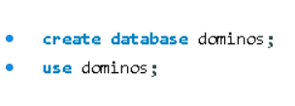
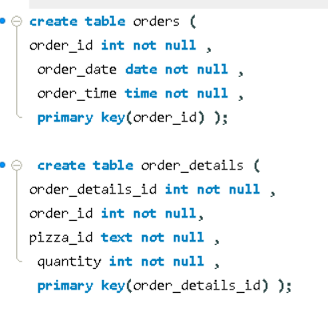
Database creation
Approach
I created a new database named dominos to organize and store the data.
Within the dominos database, I established key tables
I imported data from four CSV files into these tables to build a comprehensive dataset for analysis.
Table Creation

Slide 5
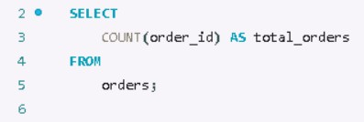

How many total orders were placed?
Explanation: The query counts the total number of orders placed in the orders table using the COUNT() function.
Insight: The total number of orders placed are 21,350.
Query:
Output:

Slide 6
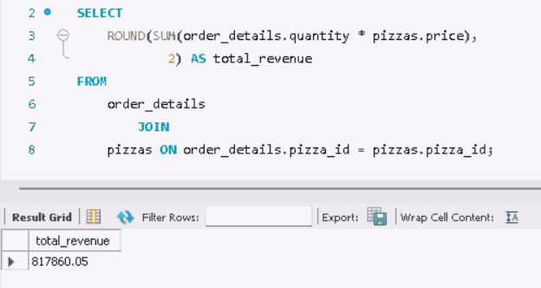
What is the total revenue generated from pizza sales?
Explanation: This query calculates the total revenue generated by multiplying the quantity of pizzas sold by their price. Insight: The total revenue generated from pizza sales is $817,860 .
Query:
Output:

Slide 7
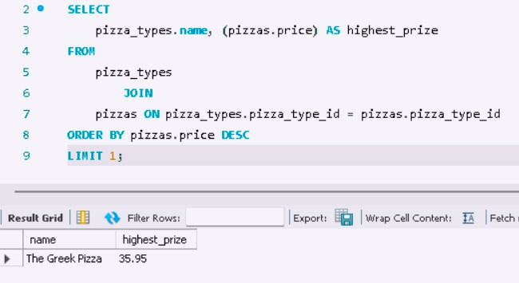
Which pizza has the highest price?
Explanation: I identified the highest-priced pizza by joining the pizza_types table with the pizzas table and ordering the results in descending order of price. The LIMIT 1 clause was used to return only the top entry, which is the highest-priced pizza.
Insight: The highest-priced pizza is The Greek Pizza, priced at $35.95
Query:
Output:

Slide 8
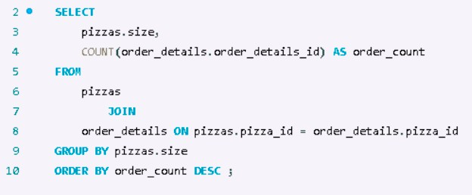
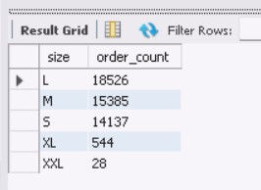
What is the most common pizza size ordered?
Explanation: To find the most common pizza size, I joined the pizzas and order_details tables. I then grouped the data by pizza size and used the COUNT() function to determine the size that appears most frequently in the orders.
Insight: The most common pizza size ordered is Large followed by Meduim and then Small.
Query:
Output:

Slide 9
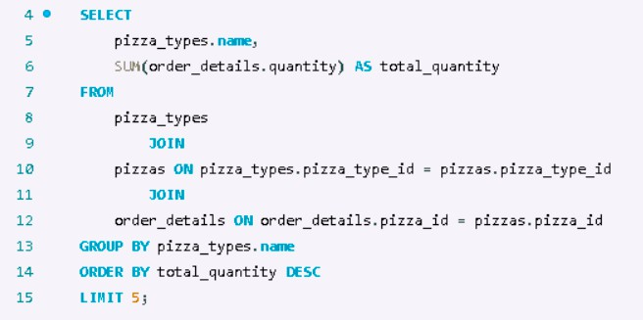
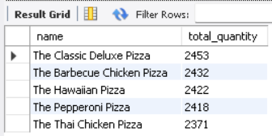
What are the top 5 most ordered pizza types, and what are their quantities?
Explanation: I determined the top 5 most ordered pizza types by joining the pizza_types, pizzas, and order_details tables. I summed up the quantities for each pizza type and ordered the results in descending order, using the LIMIT 5 clause to get the top 5 entries.
Insight: The top most ordered pizza type is The Classic Delux Pizza with over 2.4k orders.
Query:
Output:

Slide 10

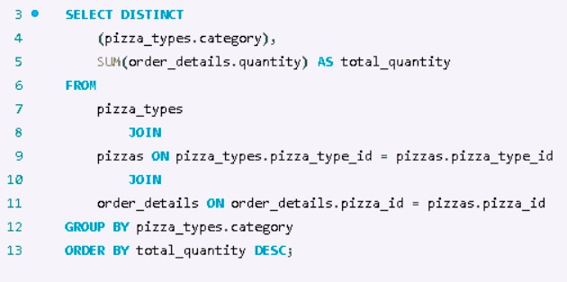
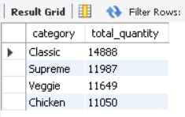
What is the total quantity of each pizza category ordered?
Explanation: By joining the pizza_types, pizzas, and order_details tables, I was able to group the results by pizza category and sum the total quantities for each category. This provided a clear picture of how many pizzas were ordered from each category.
Insight: The total quantity ordered for each pizza category is Classic with 14.8k orders, Supreme with 11.9k orders, and so forth.
Query: Output:

Slide 11
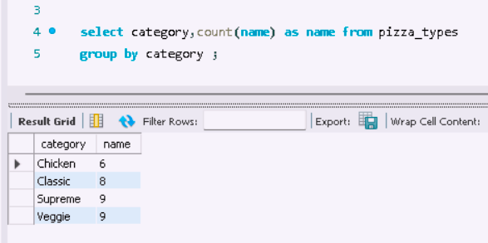
What is the distribution of pizzas by category ?
Explanation: I used a GROUP BY clause on the category field in the pizza_types table to count how many pizzas belong to each category. This query helped in understanding the popularity of different pizza categories.
Insight: The distribution of pizzas by category shows Chicken with 6 pizzas, Classic with pizzas, and so on.
Query:
Output:

Slide 12
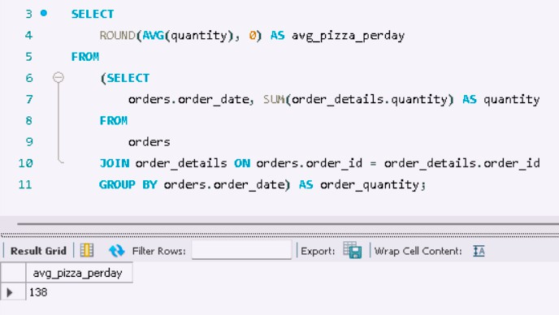
What is the average number of pizzas ordered per day when grouped by date?
Explanation: To find the average number of pizzas ordered per day, I first grouped the orders by date and summed the quantities. Then, I used the AVG() function to calculate the average number of pizzas ordered daily.
Insight: The average number of pizzas ordered per day is 138.
Query:
Output:

Slide 13

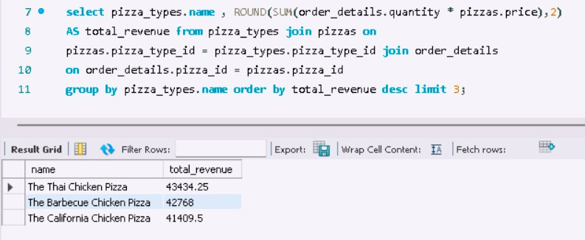
Which are the top 3 most ordered pizza types based on revenue?
Explanation: I calculated the total revenue generated by each pizza type. I then ordered the results by revenue in descending order and used the LIMIT 3 clause to identify the top 3 revenue-generating pizza types.
Insight: The top 3 most ordered pizza types by revenue are The Thai Chicken Pizza with $43434 revenue followed by Barbecue and California chicken pizza.
Query:
Output:

Slide 14
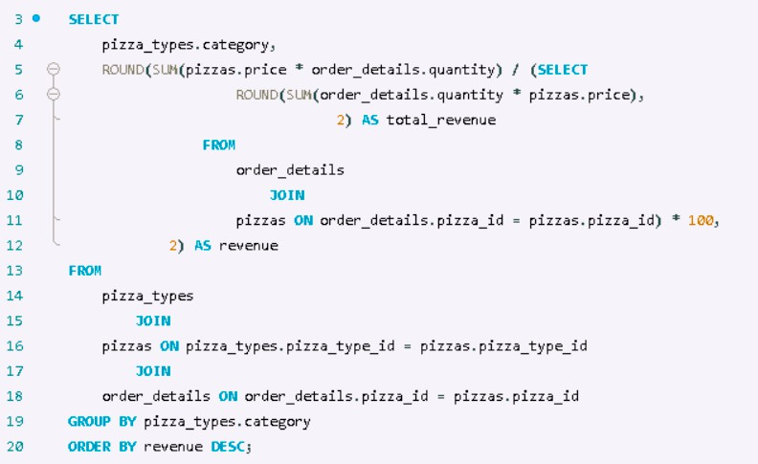
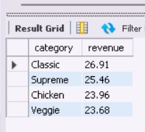
What is the percentage contribution of each pizza type to the total revenue?
Explanation: To determine the percentage contribution of each pizza type, I calculated the total revenue for each type and then divided it by the overall revenue.
Insight: The percentage contribution to total revenue is 26.91% for Classic, 25.46% for Supreme, and so on.
Query:
Output:

Slide 15
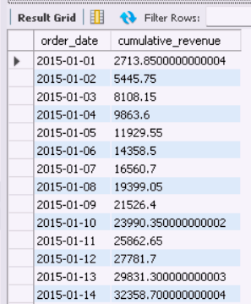
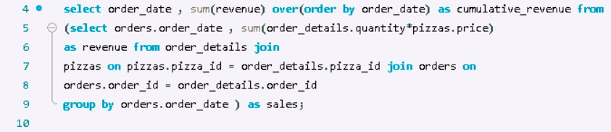
How does the cumulative revenue generated evolve over time?
Explanation: The query calculates cumulative revenue by summing daily revenues from pizza sales. A window function is used to accumulate these sums over time, showing consistent revenue growth throughout the period.
Insight: The cumulative revenue generated over time shows a steady increase, starting from $2,713.85 on 2015-01-01 and reaching $32,358.70 by 2015-01-14 and so on.
Query:
Output:

Slide 16

Summary
The analysis provides a detailed understanding of customer ordering patterns, pizza pricing, and revenue generation.
We identified the most popular pizzas, their sizes, and categories, and how these factors contribute to the overall sales and revenue.
This data-driven approach reveals opportunities to optimize menu offerings, focus on high-revenue items, and better understand customer preferences.

Slide 17

Key Recommendations
Pumping up those sales and cash flow!
Focus marketing efforts on Large and Medium pizzas, offering deals or bundles to drive sales of these popular sizes.
Feature The Thai Chicken Pizza, Barbecue, and California Chicken Pizza prominently in promotions to capitalize on their strong revenue performance.
Enhance menu offerings and promotions around the Classic and Supreme pizza categories, which have the highest order volumes and revenue contributions.

Slide 18
Conclusion
The project successfully analyzed key metrics such as total orders, revenue, and product popularity, offering actionable insights.
The findings can be leveraged to improve business strategies, such as marketing high-revenue pizzas and optimizing inventory based on demand.
Future analyses could include customer demographics and seasonal trends to further refine marketing and operational decisions.

